Slide 1
WORK ACCOUNT FOR THE PERIOD 01.07.2016 to TILL DATE
SURENDRANATH P
Staff No: IS03651
Scientist/Engineer ‘SE’
Section Head
EDP, WEB DEVELOPMENT AND TELECOM MANAGEMENT SECTION (EWTS)
MANAGEMENT INFORMATION SYSTEMS DIVISION (MISD)
PROGRAMME PLANNING AND EVALUATION GROUP (PPEG)
U.R. RAO SATELLITE CENTRE - BENGALURU
Role | Software Engineer and Section Head for EWTS, MISD, PPEG, URSC
Responsibilities | Design, Development and Maintenance of Management Information Systems (MIS) required for management and administrative related activities of URSC. Voice Communication Management of URSC campuses.
Deliverables | Successfully Designed, Developed and Operationalized ISRO/DOS PFMS Web Services Interface System (IPWS) in all ISRO Centres/Units. Realization of COINS-PFMS Interface Software. Implementation of e-Governance Initiative in URSC - Automation of various Government-to-Employee (G2E) Services. Providing online information to both Management and Employees using Sandesh system. Moving forward with Next generation of MIS system. Continuous Voice Communication services to URSC Campuses.

Slide 2
Specific Achievements
Requirement elicitation, Design, Development, Implementation, Testing, Operationalization and Maintenance of ISRO/DOS PFMS Web Services Interface System (IPWS).
Conceptual design to operationalization of COINS-PFMS Interface Software.
Published a paper on ‘e-Governance Initiative in URSC - Automation of various Government-to-Employee (G2E) Services’.
Carrying out Enhancements and Maintenance activities in Sandesh system.
Design and Development of prototype Integrated MIS system.
Augmenting and Upgradation of Voice Communication Systems at URSC campuses.

Slide 3
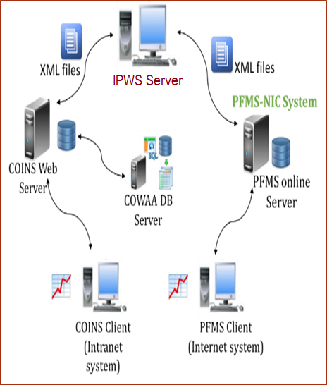
ISRO/DOS PFMS Web Services Interface System (IPWS)
Team Leader and responsible from requirement elicitation to maintenance of this system.
IPWS is background process that process XML input requests received from COINS and validate it before sending it to PFMS web services consumption system for obtaining desired responses.
Developed scripts for transferring XML files between COINS and IPWS servers using rsync utility.
Ensuring cyber security.
Presently IPWS is serving its objective satisfactorily across all ISRO centres/units.

Slide 4
COINS-PFMS Interface Software
An interface to PFMS through web service consumption using XML files.
Played key role from conceptual design to operationalization.
As a member of COINS-PFMS Interface Software Review Committee constituted by Chairman, ISRO, identified & addressed all critical issues being noticed after implementing this system and stabilizing system for day to day operational activities.
As member of PFMS Interface Software T&E committee involved in exhaustive verification and validation of COINS-PFMS Interface Software and submitted detailed test results report.
As a team leader of Code Walkthrough of COINS-PFMS Interface Software team submitted detailed report to DD, RO, SDSC.
As a member of Inter Centre Change Control Committee (ICCCC) provided necessary guidance and suggestions for proposed modifications and enhancements.
As a team leader successfully developed & implemented scripts for reconciliation of COINS monthly accounts.
Input XML Files
Input XML file over Web service
COINS
IPWS
PFMS
Response XML files as success/failure
Web service response in XML format

Slide 5
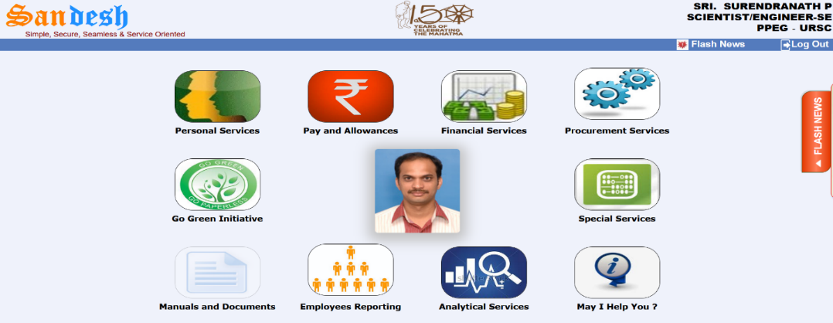
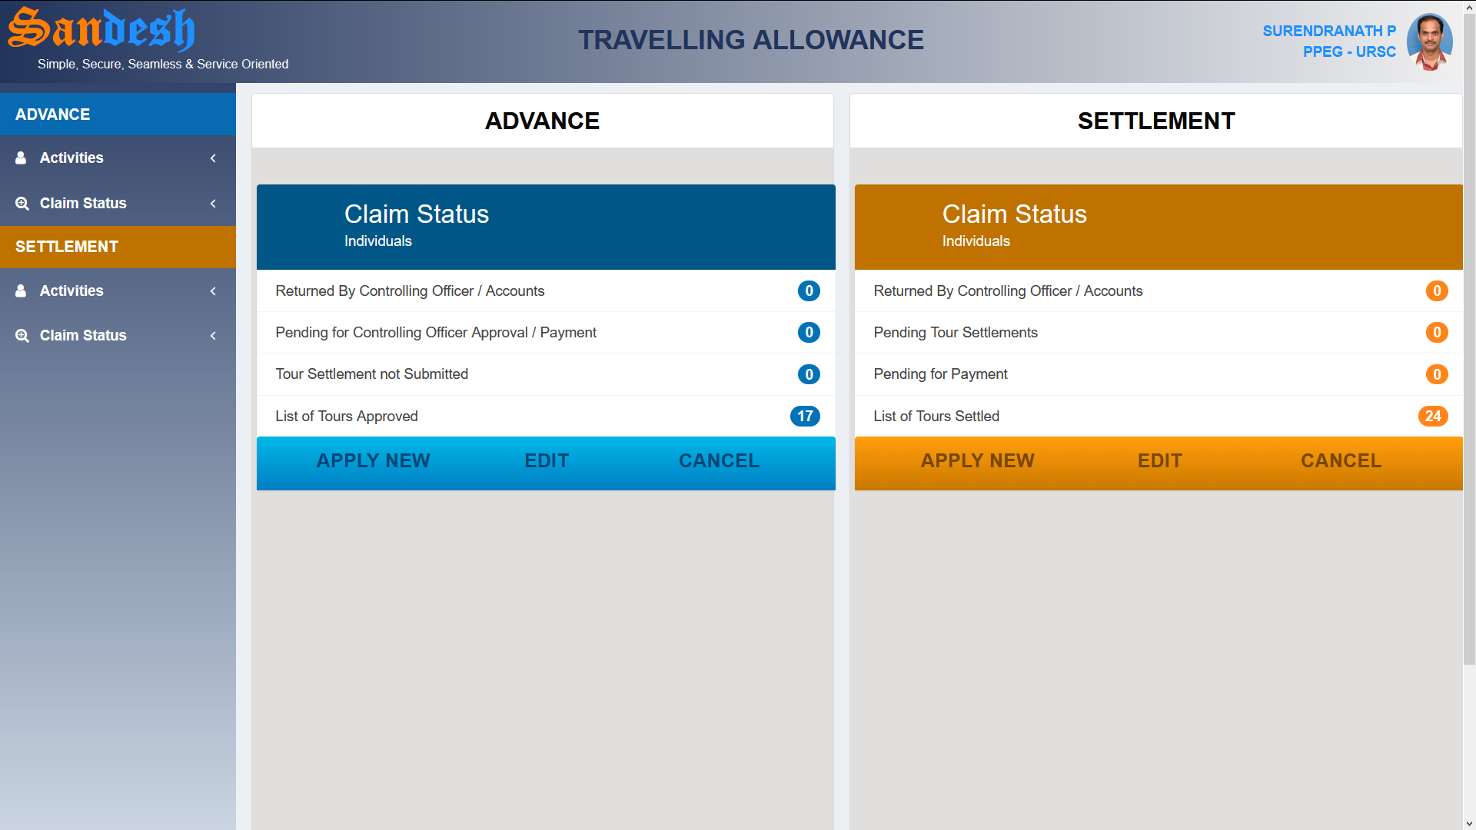
Sandesh - The Information System
Sandesh system provides required personal information to employees, MIS reports to management for decision making based on COWAA database.
After implementing this system reduced queries/calls between administration areas and employees, saved time/paper, provides effective working environment.
Comprehensive online system for Official Travelling Allowance.
Successfully implemented concept of CONNECTION POOLING concept for improving performance.
Successfully operationalized email and SMS gateway interface.
Sandesh system deployed at VSSC, LPSC(B), HSFC, MCF, ISRO HQ and PRL.

Slide 6
Other Activities
As a co-author submitted technical paper on ‘e-Governance Initiative in URSC - Automation of various Government-to-Employee (G2E) Services’ to ISRO Seminar on Computer and Information Technology (ISCIT) – 2018 and same has been selected for oral presentation.
Designed and developed a prototype model and demonstrated to fetch the data from multi-disciplinary databases over the network using latest SPRING-BOOT Technology.
This demonstrates data retrieved from across all ISRO centers can be processed at a common server to extract desired outcome which shall help management for decision making.
Implemented software latest version control system using Git tool for all software developmental activities of MISD/PPEG, URSC.
Responsible for operation and maintenance of the finance, accounts, purchase and stores and payroll related modules of COINS.

Slide 7
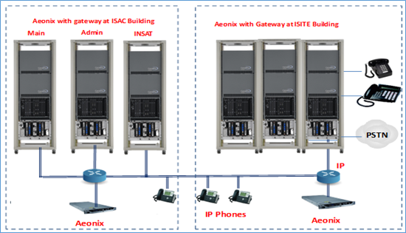
Voice Communication Management of URSC
As an ‘Engineer In-charge, Telephones’ responsible for providing continuous voice communication services at URSC campuses.
Responsible for maintenance and ensure stability for day to day operations of the Electronic Private Automatic Branch Exchange (EPABX) systems.
Realization of upgradation and augmentation in URSC/ISITE EPABX systems.
Provided 600 additional telephone connections by reusing of ISTRAC EPABX system components, in effect saved about ₹35 lakhs to organization.
Proposed configuration of upgradation and augmentation in URSC/ISITE EPABX systems

Slide 8
Thank You

